Slide 1
Feature Learning and Importance Scoring on Incomplete Anomaly Datasets
Bachelor Thesis Initial Presentation
Julian Hoffmeister
06/10/2022
Research Supervisor:
Andreas Lohrer
Responsible Professor:
Prof. Dr. Peer Kröger

Slide 2
Contents
Introduction
Related Work
Research Questions
Concept
Evaluation and Metrics
Schedule

Slide 3
Introduction
How can we fill the missing values in order to optimize cluster performance?
ID | A | B
1 | 1 | 7
2 | 3
3 |  | 3
4 | 2
5 | 1 | 6
6 | 2 | 5
7 | 2 | 6
8 | 3 | 7
9 | 6 | 2
10 | 7
11 | 7 | 3
12 | 8 | 1
13 | 6 | 3
14 | 7 | 2
15 | 7 | 4
16 |  | 1
B
MV data
Complete data
A

Slide 4
Introduction
Cluster Performance?
Clearly distinguishable clusters
Few or no outliers
ID | A | B
1 | 1 | 7
2 | 3 | 6
3 | 8 | 3
4 | 2 | 7
5 | 1 | 6
6 | 2 | 5
7 | 2 | 6
8 | 3 | 7
9 | 6 | 2
10 | 7 | 3.5
11 | 7 | 3
12 | 8 | 1
13 | 6 | 3
14 | 7 | 2
15 | 7 | 4
16 | 7 | 1
B
A

Slide 5
Introduction
Cluster Performance?
Clearly distinguishable clusters
Few or no outliers
ID | A | B
1 | 1 | 7
2 | 3 | 2
3 | 1 | 3
4 | 2 | 2
5 | 1 | 6
6 | 2 | 5
7 | 2 | 6
8 | 3 | 7
9 | 6 | 2
10 | 7 | 1
11 | 7 | 3
12 | 8 | 1
13 | 6 | 3
14 | 7 | 2
15 | 7 | 4
16 | 1 | 1
B
Avg(A)
A

Slide 6
Introduction
Cluster Performance?
Blurry borders
outliers
ID | A | B
1 | 1 | 7
2 | 3 | 4
3 | 4 | 3
4 | 2 | 3
5 | 1 | 6
6 | 2 | 5
7 | 2 | 6
8 | 3 | 7
9 | 6 | 2
10 | 7 | 5
11 | 7 | 3
12 | 8 | 1
13 | 6 | 3
14 | 7 | 2
15 | 7 | 4
16 | 7 | 1
B
A

Slide 7
Introduction
Learn filling values by optimizing cluster performance metrics
ID | A | B
1 | 1 | 7
2 | 3 | ?
3 | ? | 3
4 | 2 | ?
5 | 1 | 6
6 | 2 | 5
7 | 2 | 6
8 | 3 | 7
9 | 6 | 2
10 | 7 | ?
11 | 7 | 3
12 | 8 | 1
13 | 6 | 3
14 | 7 | 2
15 | 7 | 4
16 | ? | 1
B
Missing Values
Cluster Performance
A

Slide 8
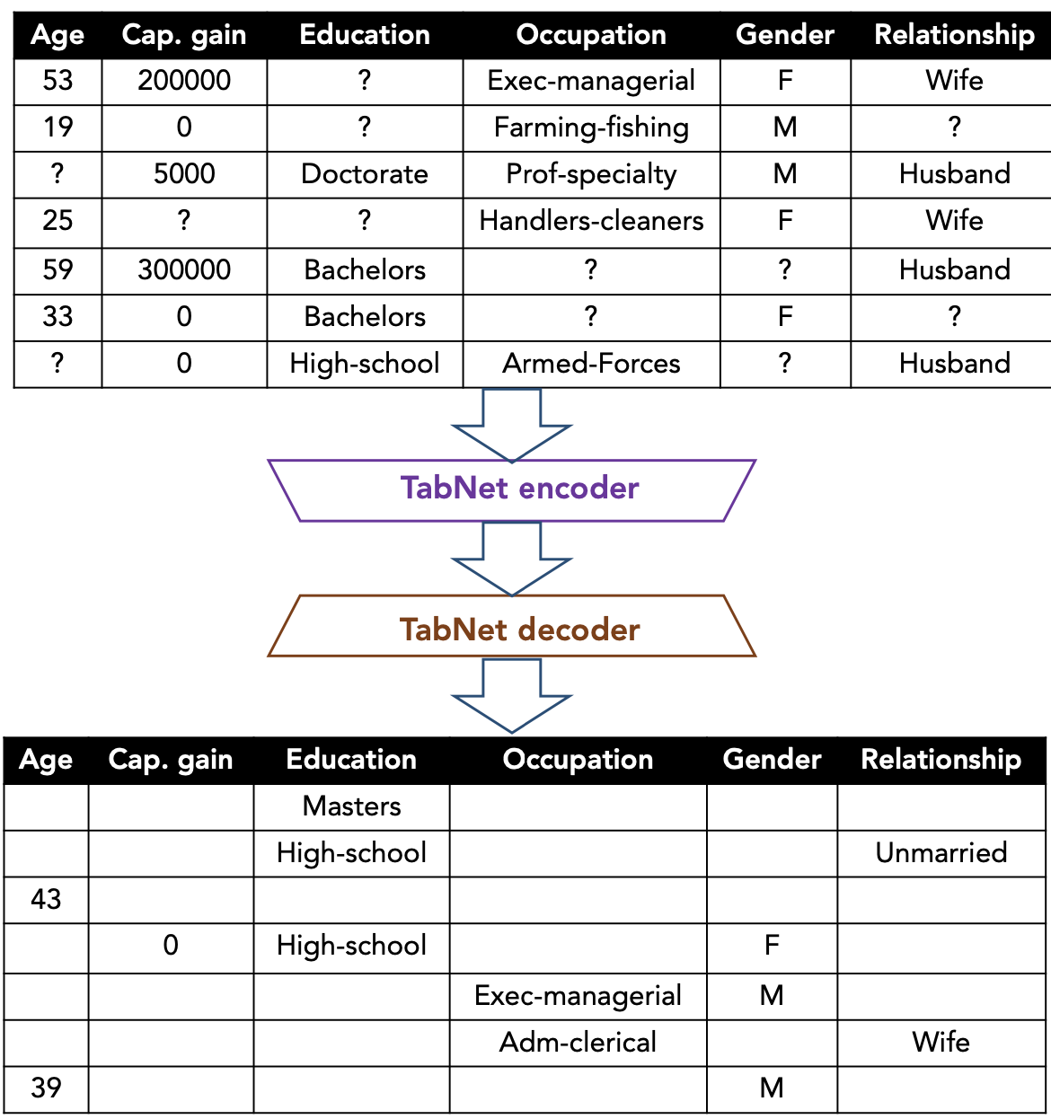
Learning Missing Values
TabNet: S. Ö. Arik, T. Pfister. 2020. TabNet: Attentive Interpretable Tabular Learning. arXiv:1908.07442v5
Transformer architecture
Attentive Transformers
Feature Transformers
Sequential attention mechanism
Used here to predict missing values in tabular data
Interpretability: TabNet attention matrices could help to derive feature importance and improve explainability
Notes:
Classical filling strategies such as heuristics (mean, median, …) or distribution based do not fullfill the “learning” criteria

Slide 9
TabNet is a deep tabular data learning architecture that uses sequential attention to choose which features to reason from at each decision step.
The TabNet encoder is composed of a feature transformer, an attentive transformer and feature masking. A split block divides the processed representation to be used by the attentive transformer of the subsequent step as well as for the overall output. For each step, the feature selection mask provides interpretable information about the model’s functionality, and the masks can be aggregated to obtain global feature important attribution. The TabNet decoder is composed of a feature transformer block at each step.
In the feature transformer block, a 4-layer network is used, where 2 are shared across all decision steps and 2 are decision step-dependent. Each layer is composed of a fully-connected (FC) layer, BN and GLU nonlinearity. An attentive transformer block example – a single layer mapping is modulated with a prior scale information which aggregates how much each feature has been used before the current decision step. sparsemax is used for normalization of the coefficients, resulting in sparse selection of the salient features.

Slide 10

Research Questions
RQ 1
How is it possible to improve clustering of missing values/dimensions datasets with model based filling strategies?
1
2
n
 |  | . . .
RQ 2
How does the number of dimensions influence the cluster/outlier results?
RQ 3
How is it possible to make model based filling strategies explainable?

Slide 11

1 Datasets
2 Filling Strategies
3 Filled Datasets
4 Clustering
5 Performance Indices
!
!
Custom
loss function
!
!
!
!
!
dataset 1

Slide 12
1.1 Select Datasets
1.2 Choose Feature
1.3 Generate Missing Values
dataset 1
dataset 2
dataset 3

Slide 13
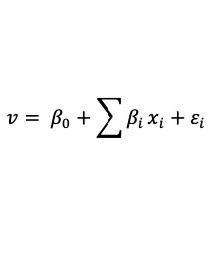
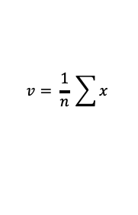
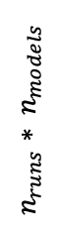
Missing Value Datasets
2.1 Mean Substit.
3 Data Reconstruction
$$v= \frac{1}{n} \sum{x}$$
2.2 Lin. Regression
$$v= β_{0}+\sum{β_{i}}x_{i}+ε_{i}$$
2.3 Non-linear Regression
$$n_{runs}∗ n_{models}$$
Custom loss function

Slide 14
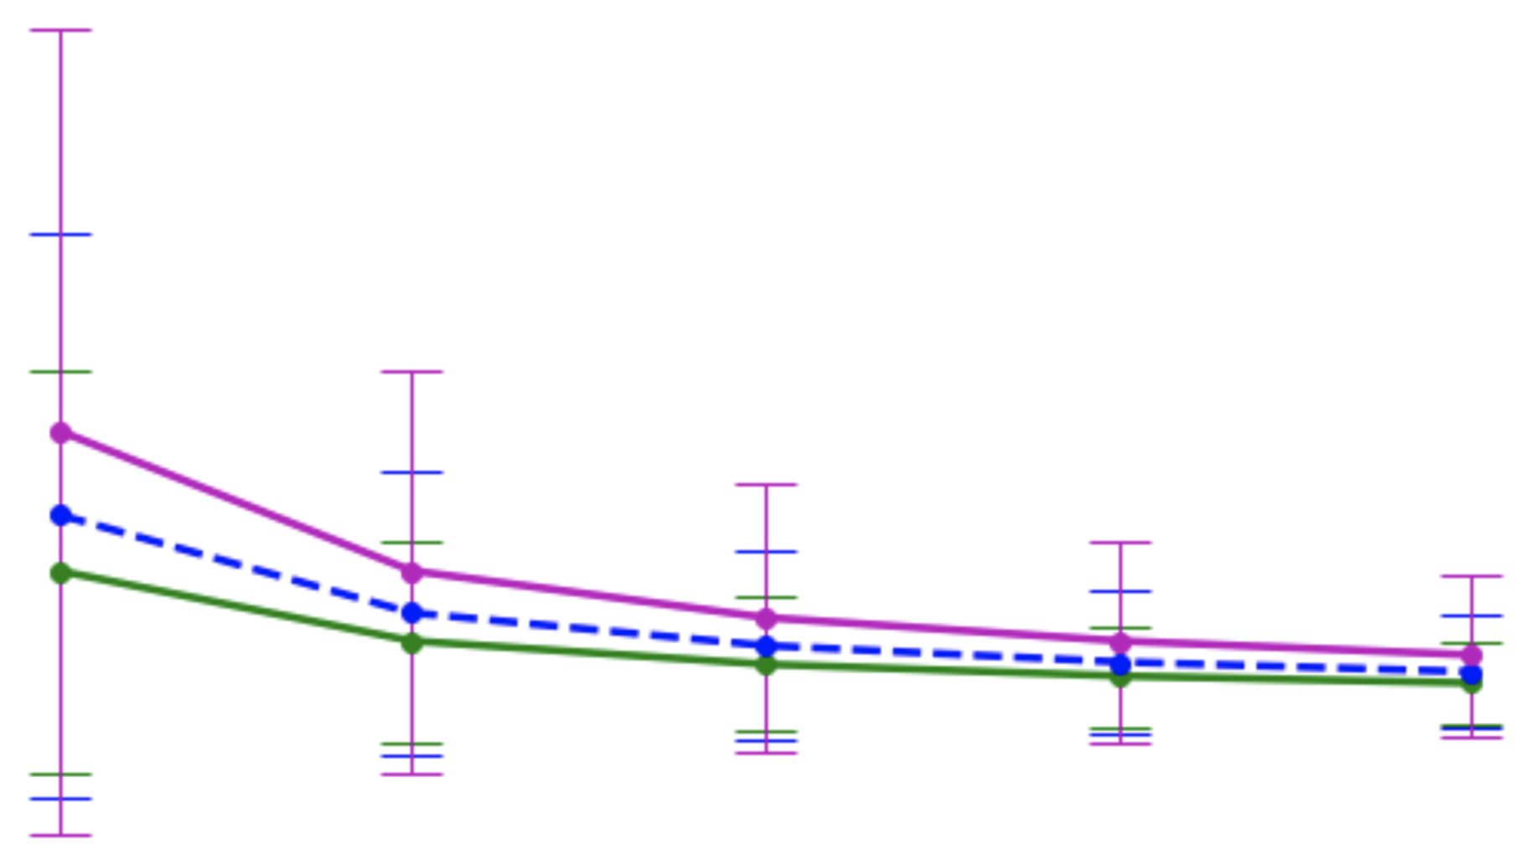
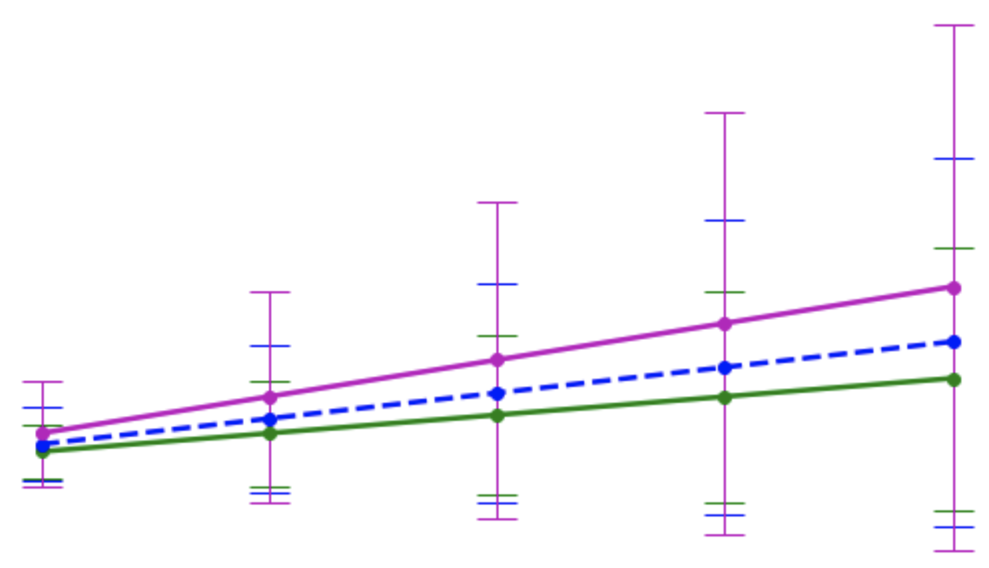
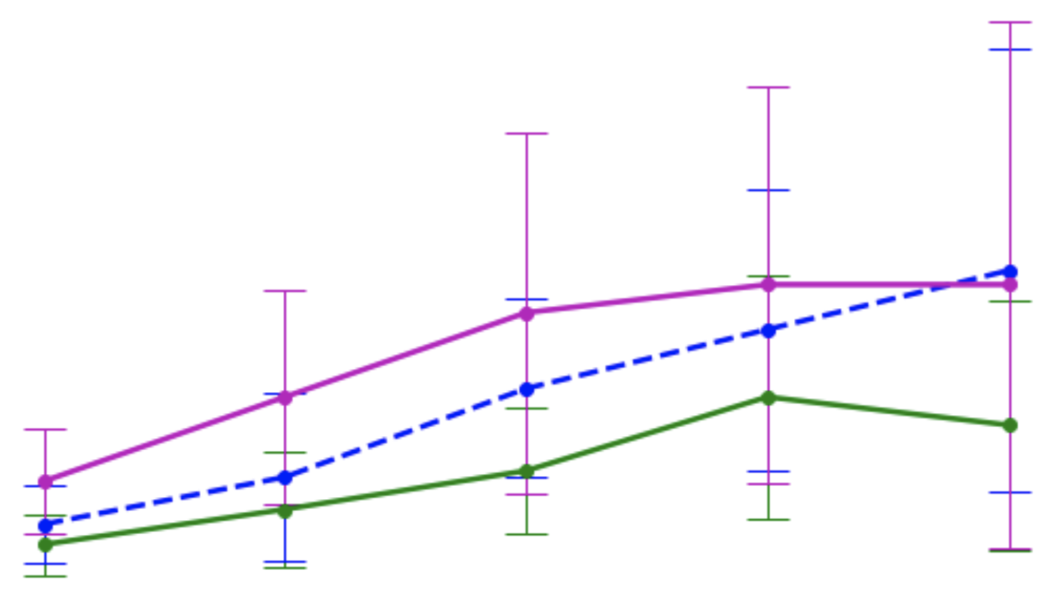
Reconstructed Data
4 Clustering
5 Performance Indices
5.1 Distribution Score
5.2 Outlier Score
5.3 Clustering Accuracy

Slide 15
Concept – RQ1
How is it possible to improve clustering of missing values/dimensions datasets with model based filling strategies?
3: Clustering:
e.g. DBSCAN with constant hyperparameters and different Datasets
Or DeepDPM:
advantage – learn from dataset, learn cluster amount k
But check before, if DeepDPM can handle missing values already
λ
Custom loss function
1 Datasets
3 Full Datasets
4 Clustering
5 Performance Ratings
2 Filling Strategy

Slide 16
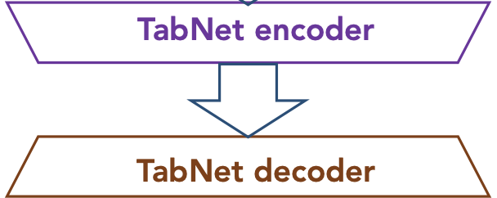
Concept – RQ2
How does the number of dimensions influence the cluster/outlier results?
λ
2 Filling Strategy
1 Datasets
3 Full Datasets
4 Clustering
n runs
randomly omit
x% of features
Custom loss
function
5 Performance Ratings
6 Feature importance
(derived from the impact of missing
features on the cluster performance)

Slide 17
Concept – RQ3
How is it possible to make model based filling strategies explainable?
λ
2 Filling Strategy
1 Datasets
3 Full Datasets
4 Clustering
Custom loss
function
use TabNet input (missing value datasets) and output (filled dataset) to create a decision tree
5 Performance Ratings

Slide 18
1 Datasets
2 Filling Strategies
3 Filled Datasets
4 Clustering
5 Performance Metrics
?
?
!
!
?
?
!
!
?
?
!
!
?
!

Slide 19
1.1 Select Datasets
1.2 Choose Feature
1.3 Generate Missing Values
dataset 1
dataset 2
dataset 3

Slide 20
Missing Value Datasets
2.1 Mean Substit.
3 Data Reconstruction
$$v= \frac{1}{n} \sum{x}$$
2.2 Regression
$$v= β_{0}+\sum{β_{i}}x_{i}+ε_{i}$$
2.3 TabNet
Custom loss function

Slide 21
Evaluation and Metrics
RQ 1
Baseline: cluster performance after 1 step (no performance optimisation)
Comparison value: cluster performance after optimisation loops
1
2
n
RQ 2
Cluster results: changes in cluster performance based on # of dimensions
Outlier results: changes in outlier metrics (variance, Kurtosis)
 |  | . . .
RQ 3
To be defined
Verification of decision tree by domain experts?

Slide 22
Schedule
1
2
3
4
5
6
7
8
9
10
11
12
13
14
15
16
17
18
19
20
Literature research
Concept
Concept Implementation
Experiments
Thesis Writing
Review and Adaption
Talks & Presentation
Buffer

Slide 23
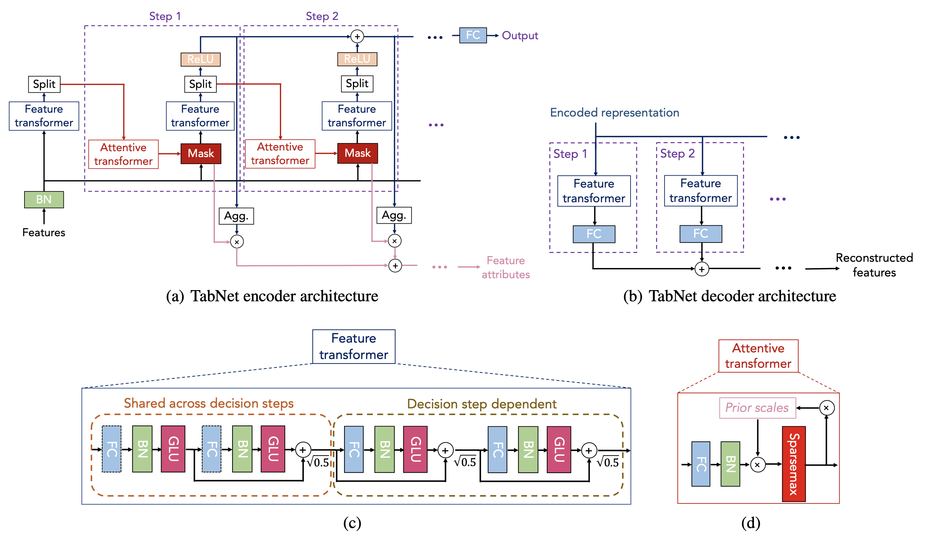
TabNet Architecture
Split:
Attention goes to next step
Predictions are added up

Slide 24
TabNet Architecture

Slide 25
Concept
Datasets
Degrees of freedom:
Source (real vs toy)
Datasets (number)
Distribution of MVs (per feature: completely random, not random, …)
Use existing datasets and create missing values (with configurable degree)
Use real world datasets with missing values

Slide 26
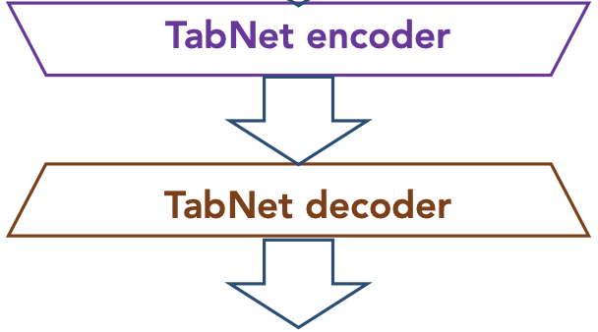
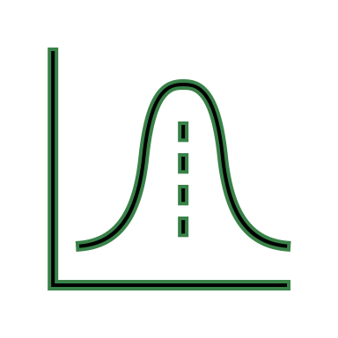
Concept
Models
Distributions
Apply filling strategies to create multiple datasets in different versions
E.g. TabNet,
VIME
Degrees of freedom:
Strategies
Parameters
Heuristics
mean
random
…

Slide 27
Concept
Models
Heuristics
Distributions
characterize features
outlierness,
(co)variance,
correlation, etc.

